Slide 1

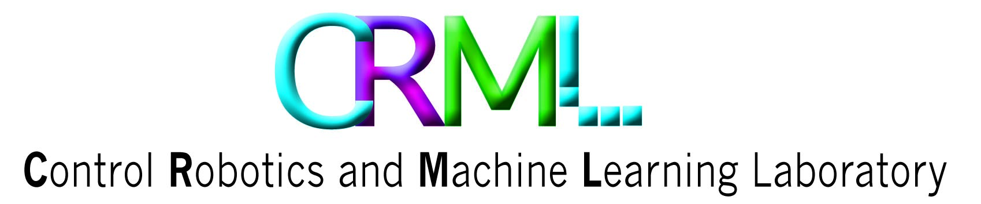

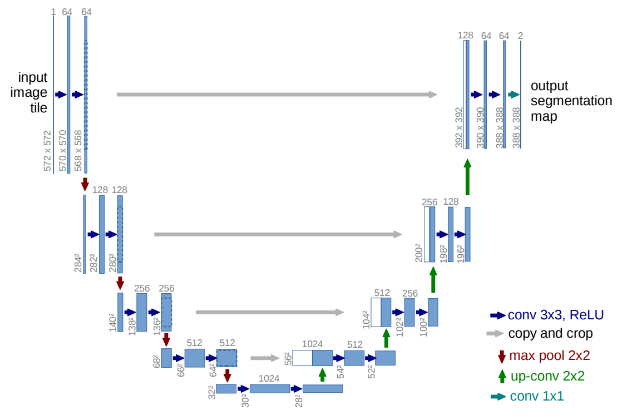
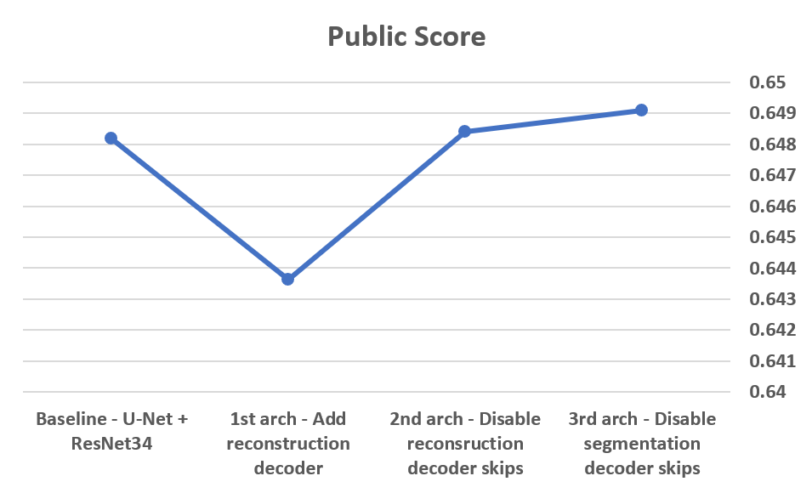
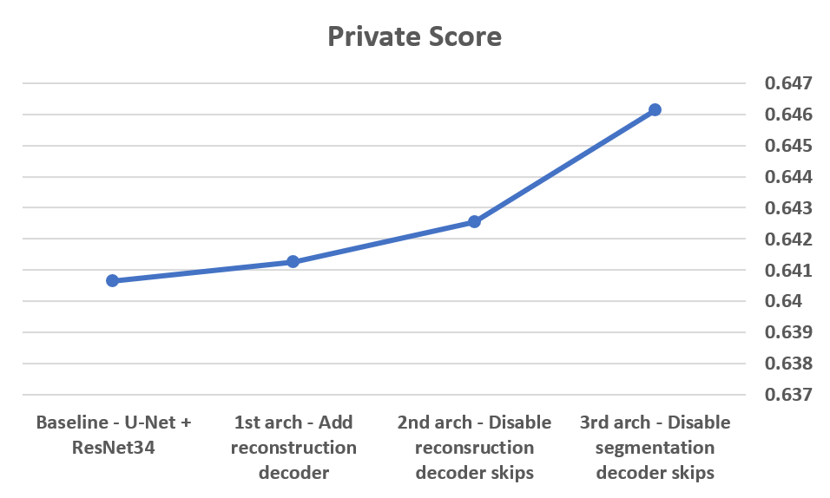
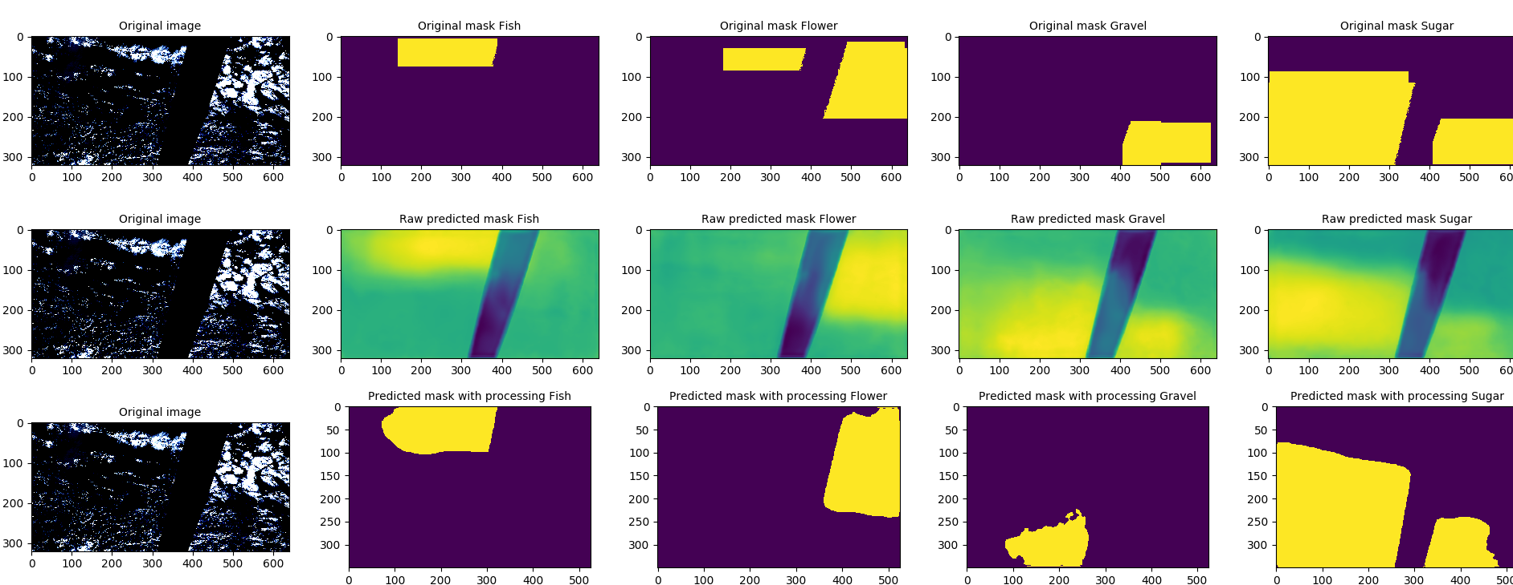
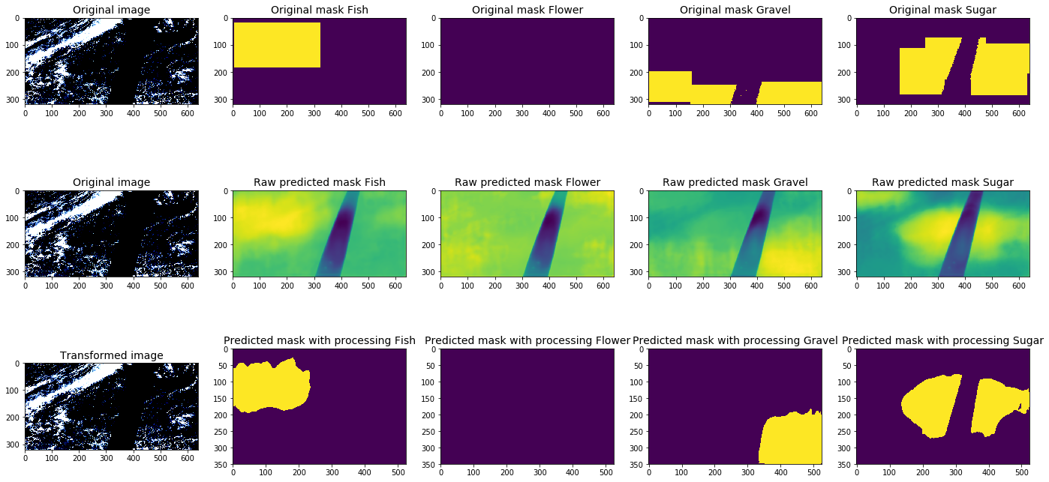
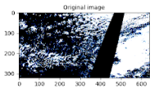
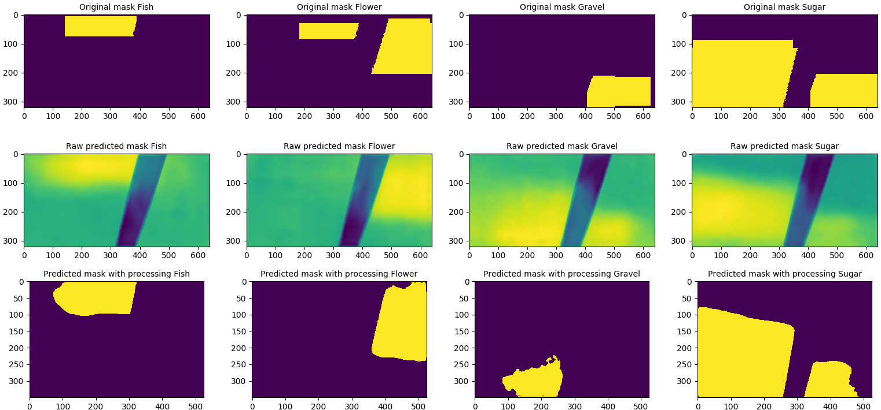
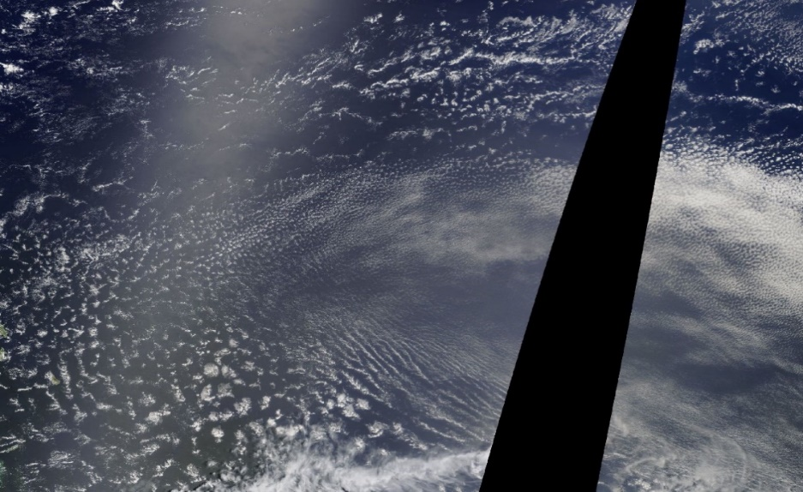
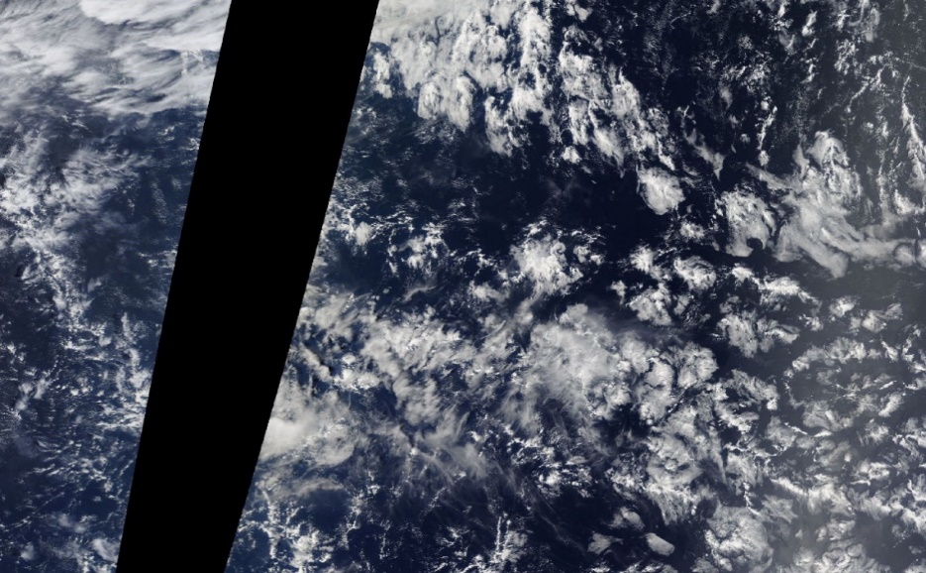
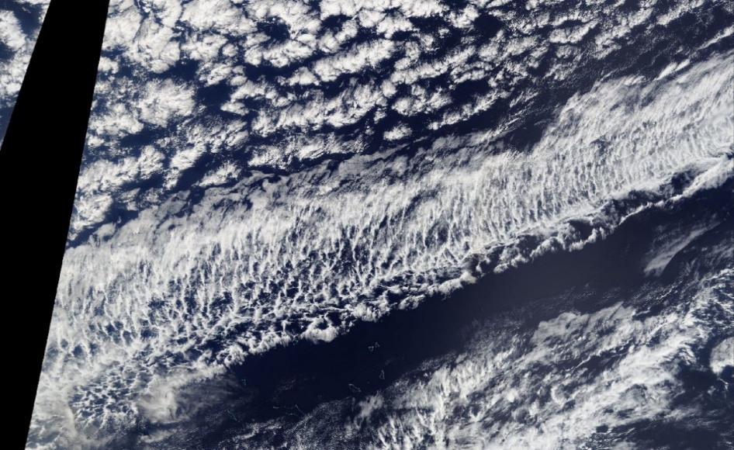
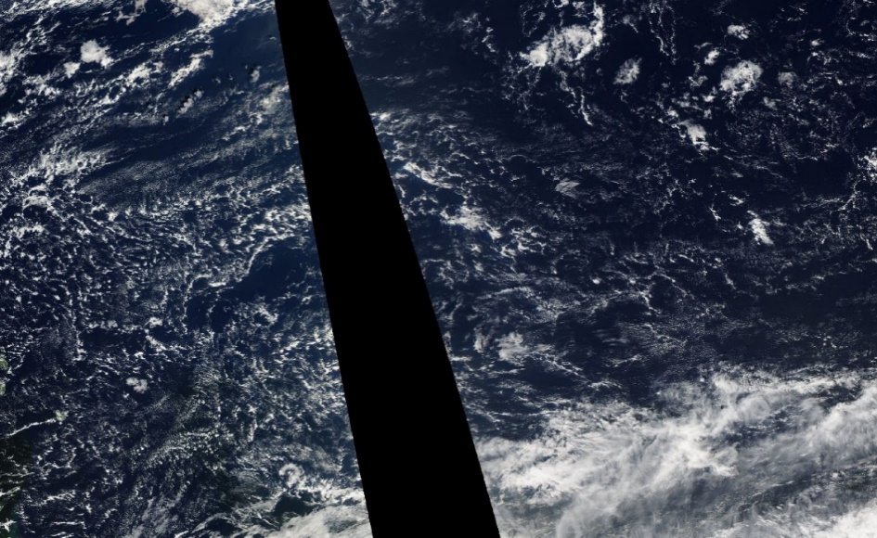
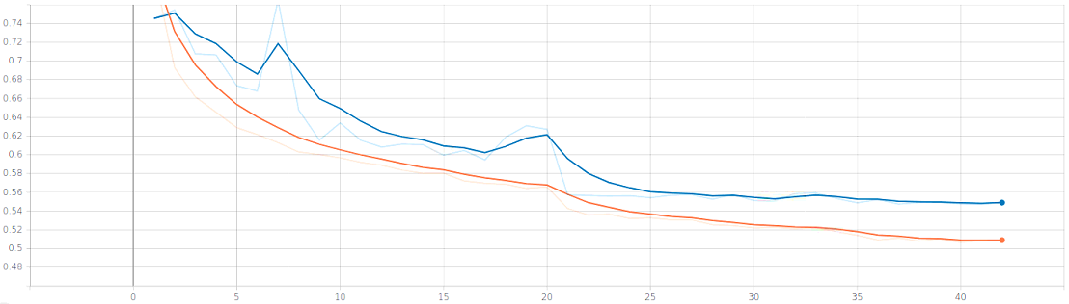

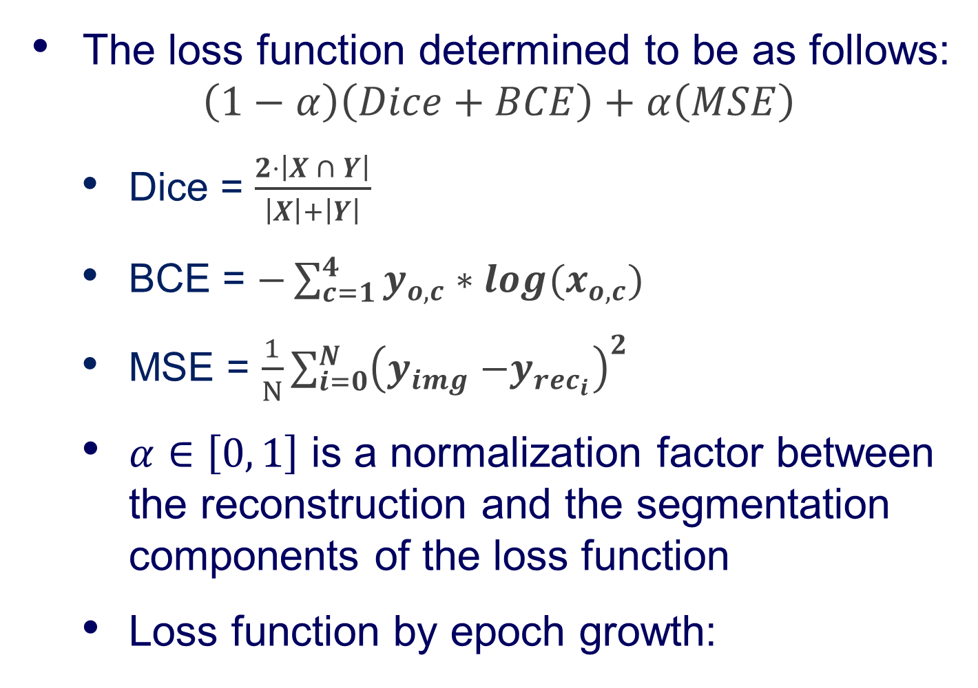
Implementing Unsupervised Learning Method in U-Net Segmentation Architecture
Hod Raz and Avshalom Dayan, Supervised by Eyal Ben David
Introduction
Task Data
Results
U-Net is a widely used, state-of-the-art supervised learning segmentation DNN architecture
It utilize an encoder-decoder architecture and skip connections between them for a better localize data flow
The dataset consists of ~9.2 K images (5.5 K of train images and 3.7 K of test images)
Our results are being compared to a baseline we started from and two architecture change we made
Baseline – U-Net with Resnet encoder
1st architecture – adding reconstruction decoder
2nd architecture – no skips connections inside the reconstruction decoder
3rd architecture - no skips connection in both decoders
Data Distribution
Number of images by the number of cloud types included in them:
Number of instances of cloud types in the dataset:
Evaluation
Using mean dice coefficient, given by the following formula $\frac{2⋅\left|X ∩ Y\right|}{\left|X\right|+\left|Y\right|}$ , such that: $X$ is the ground truth set; $Y$ is our prediction set
Score is given by Kaggle’s evaluation system
* Public score – consists of 25% of the test set
* Private score – consists of 75% of the test set, therefore more valuable
Visualized Results
U-Net architecture, O. Ronneberger, 2015
1st row – GT tags from Kaggle for every cloud type
2nd row – heat maps created by our model to understand the approximate location of the cloud
3rd row – prediction masks of our model
Goals
Final Architecture
Improving U-Net segmentation architecture by implementing unsupervised learning method (auto-encoder) as a secondary decoder
Demonstrate our solution on a use-case – Kaggle competition: “Understanding Clouds From Satellite Images”
A Reset34 encoder is connected to:
U-Net – based reconstruction decoder (upper path)
U-Net – based segmentation decoder (lower path)
Reconstruction
Decoder
Task Overview
Encoder
(ResNet34)
Segmentation
Decoder
Post-processing
Building a model to classify and segment cloud organization patterns from satellite images
Shallow clouds play a key role in determining the Earth’s climate
An automated system of cloud segmentation can help researches build better climate models
Cloud organizations to classify:
Encoder & Decoders
Input
Image
No
Skip
No
Skip
Level 1
No
Skip
256
Conv 3x3 ReLU
No
Skip
Sugar cloud
Flower cloud
Crop & Skip
No
Skip
Max pool
No
Skip
Up-Conv 2x2
No
Skip
* Skips are completely disabled in the segmentation decoder
Loss
Dusting of very fine clouds, little evidence of self-organization
Large-scale stratiform cloud features appearing in bouquets.
Well separated from each other
The loss function determined to be as follows: $\left(1−α\right)\left(Dice+BCE\right)+α\left(MSE\right)$
Dice = $\frac{2⋅\left|X ∩ Y\right|}{\left|X\right|+\left|Y\right|}$
BCE = $−\sum_{c=1}^{4}{y_{o,c}∗log(x_{o,c})}$
MSE = $\frac{1}{N}\sum_{i=0}^{N}{{\left(y_{img}{−y}_{rec_{i}}\right)}^{2}}$
$α∈\left[0, 1\right]$ is a normalization factor between the reconstruction and the segmentation components of the loss function
Loss function by epoch growth:
Conclusions
Fish cloud
Gravel cloud
Better performance can be achieved by implementing unsupervised learning method (auto-encoder) to U-Net
Due to the unsupervised nature of our solution, it can be added to similar architectures (U-Net variants) and improve them with no additional data.
Localized information that originally provided by skips connections can be obtained using the reconstruction decoder instead
Large-scale skeletal networks of clouds separated from other cloud forms
Meso-beta lines of arcs defining randomly interacting cells with intermediate granularity
valid
train
April 2020

